Slide 1
CM4044 Project 1 Prediction of Second Hand Car Price
Benjamin Chan Sin Teck (U1940715L)
Carl Neo Dun Qi (U1940041G)
Chia Yee Sheun (U1940627E)

Slide 2
Table of Contents
01
Significance of dataset chosen
05
Machine Learning models applied
02
Dataset
Information
Parameters
Tuning
06
03
Data
Cleaning
07
Comparison between the ML
04
Data
Visualization
08
Conclusion/Future Ideas

Slide 3
Significance of Dataset Chosen
1
Cost of COEs continues to increase over the year
Significance of Dataset Chosen
2
A new car can depreciate by as much as 30% in the first year
3
Most of its depreciation cost is absorbed by the first owner
4
Lower premiums for insurance coverage
5
Less waiting time to get the car

Slide 4
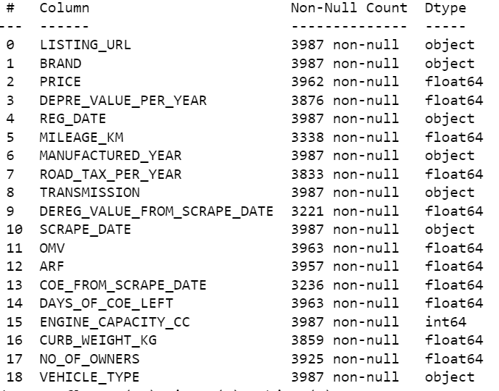
Dataset information (Raw)
Dataset from sgcarmart
19 Columns
Near to 4000 rows per column
Several object type variable that needed modification

Slide 5

Data Cleaning

Slide 6
Data Cleaning Steps
1. Dropping Unnecessary Columns
Listing Url, Scrape Date, No.of owners
5. Categorization of Categorical Variables
Transmission (Auto and Manual)
One hot-encoding
Auto -> 0, Manual -> 1
Car Brand Categorization Vs Vehicle Type
2. Treating NA values (2662 NA values)
Imputative Method vs Dropping NA values
4. Adding a new column, Car Age
More intuitive to interpret how old a car is compared to its manufactured date
Scrape Date - Manufactured Year
3. DateTime Conversion
Manufactured Year, Registration Date, Scrape Date
Notes:
Vehicle type classification is vague
Car Brand seems to be better as it conveys the perceived desirability of the vehicle.
Vehicle type column will be dropped

Slide 7
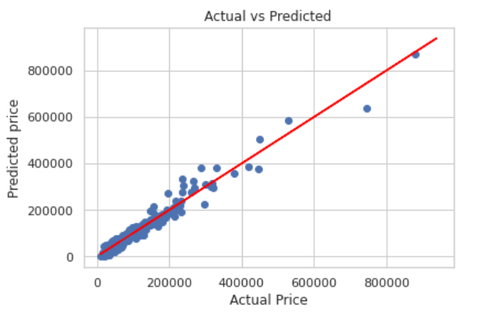
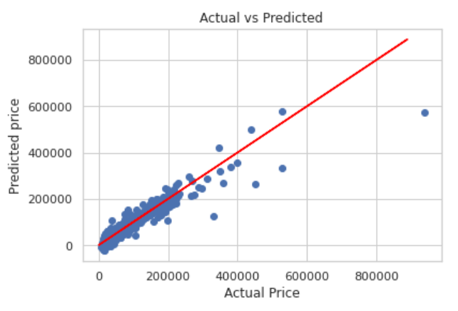
Drop NA vs Imputative Method
Using Linear Regression Model to compare between the two methods
Drop NA | Imputative method
R2 = 0.955 RMSE: 16391 | R2 = 0.860 RMSE: 25269

Slide 8
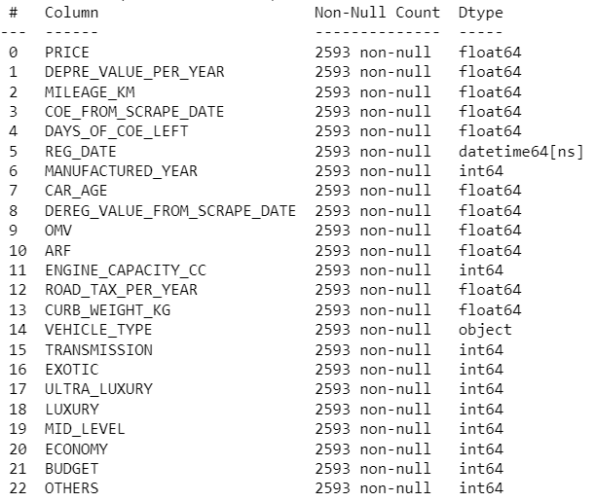
Dataset Information (After Cleaning)
23 columns, 2593 rows
Column 16-22 were classified into Brand Types for easier data visualization
Target Variable Price
Predictor Variables 16 variables
Brand Types

Slide 9
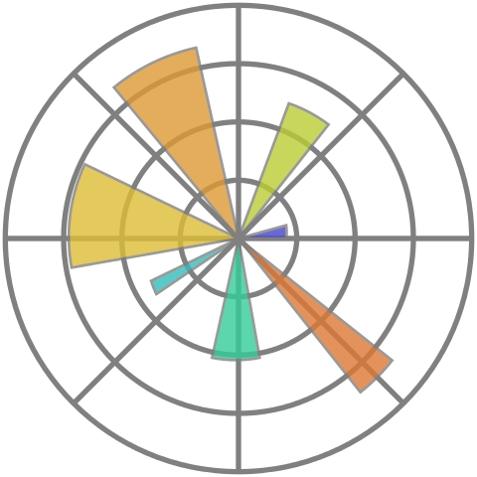
Data Visualization -
Feature Selection

Slide 10
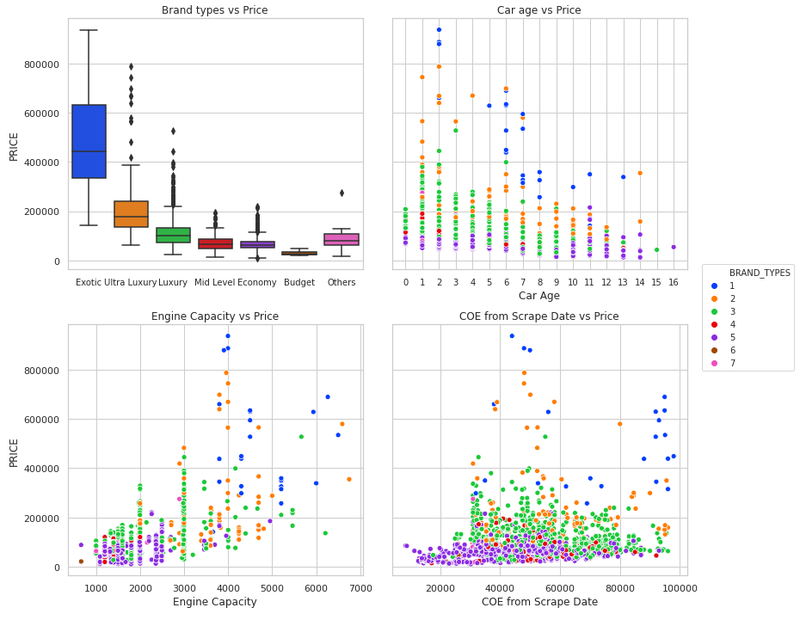
Removing Brand Types Column
1 - Exotic
2 - Ultra Luxury
3 - Luxury
4 - Mid Level
5 - Economy
6 - Budget
7 - Others
Notes:
Brand Types is very much biased towards price.
Scatterplot of brand types vs price - 1-exotic is at a higher price range.
Scatterplot of car age vs price - despite two cars have the same car age, pricing are different due to branding.
Conclusion: Dropped Brand Types

Slide 11
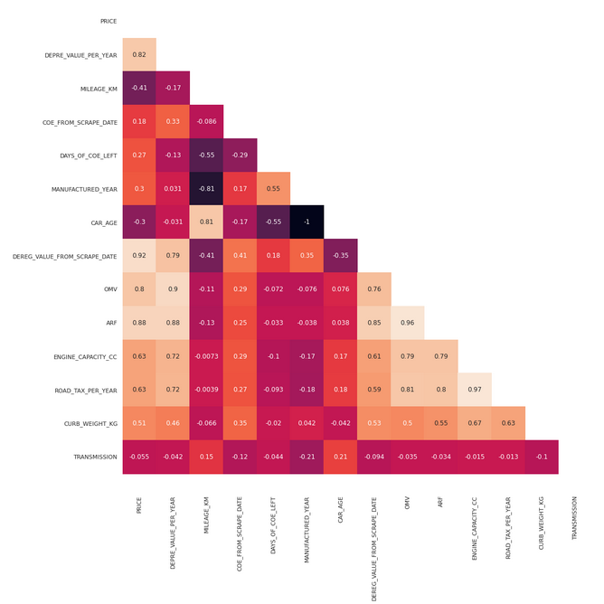
Data Visualisation - Heatmap
Problem!!
Few independent Variables are highly correlated

Slide 12
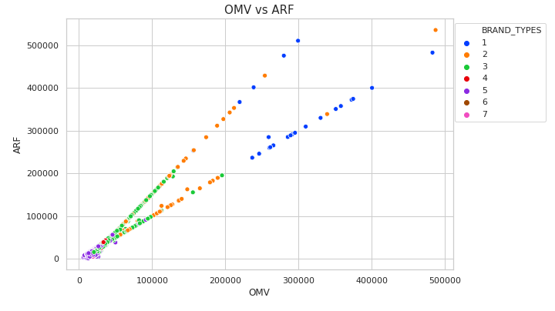
Scatter plot (OMV & ARF)
Features | Drop | Reasons
OMV and ARF 0.96 correlation | ARF | The Additional Registration Fee (ARF) is a tax levied upon car registration. It is based on a percentage of the vehicle's Open Market Value (OMV). According to the correlation matrix, they have a 0.96 correlation.

Slide 13
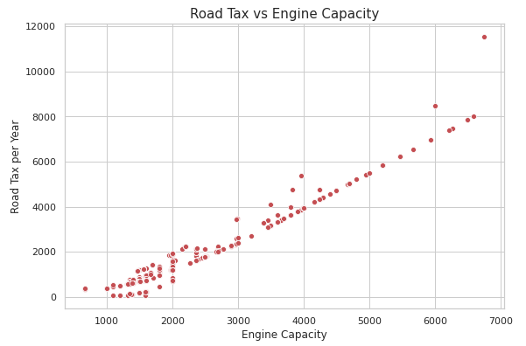
Scatter plot (Road Tax & Engine Capacity)
Features | Drop | Reasons
Engine CC and Road Tax 0.97 correlation | Road Tax | Road tax increases as engine CC increases. Including Road Tax would therefore introduce multicolinearity into the model, as both explain the same phenomenon. They correlate with one another 0.97 according to the correlation matrix.

Slide 14
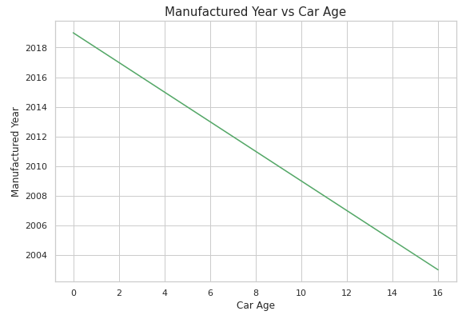
Scatter plot (Manufactured Year & Car Age)
Features | Drop | Reasons
Manufactured Year and Car Age -1 correlation | Manufactured year | Manufactured year can be omitted as Car Age is determined by the year of manufacture. They have a correlation of -1 according to the correlation matrix.

Slide 15
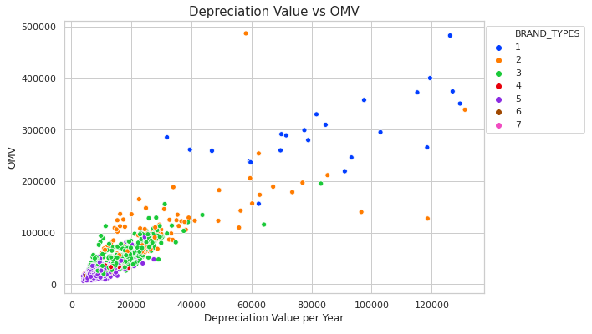
Scatter plot (Depreciation Value & OMV)
Features | Drop | Reasons
Depreciation and OMV 0.90 correlation | Depreciation | Annual depreciation is the amount of money that the owner loses on the value of the vehicle each year. Depreciation = (List Price - Minimum PARF value) ÷ years of COE remaining The Open Market Value (OMV) or Additional Registration Fee (PARF) determines the minimum Preferential Additional Registration Fee (PARF). Hence, the correlation between depreciation and OMV is 0.90.

Slide 16
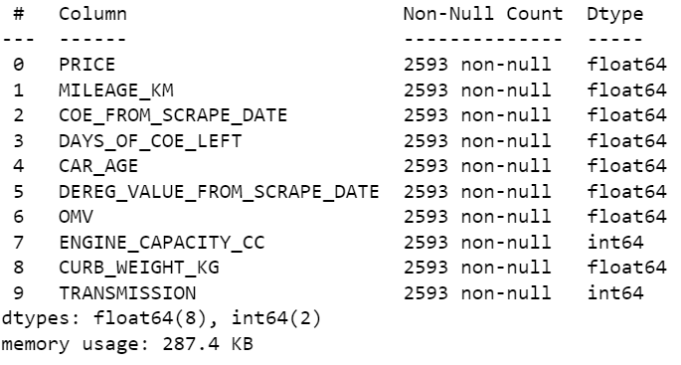
Finalized Features
Target variable
Features

Slide 17
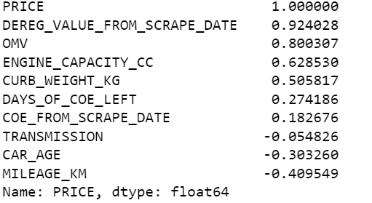
Finalized Features
Correlation with price

Slide 18
Machine Learning Models
Linear Regression
Ridge and Lasso Regression
Decision Tree Regression
Random Forest Regression
XGBOOST
KNN Regression

Slide 19
Cross Validation Scores - Comparison
Gives a more accurate indication of how well each model generalizes to unseen data.
5-Fold Cross validation (scoring = R²)
Results | Linear Regression | DecisionTree | Random Forest | XGboost | kNN Regression
CV (R²) | 0.92699 | 0.91155 | 0.95743 | 0.96090 | 0.94347

Slide 20
Results (Before Hyperparameters Tuning)
Results | Linear Regression | DecisionTree | RandomForest | XGboost | kNN Regression
RMSE | 16391.526 | 24885.977 | 14136.039 | 12618.054 | 13435.826
R² | 0.95535 | 0.89709 | 0.96679 | 0.97354 | 0.97000
MAE | 10647.978 | 10394.927 | 6901.744 | 6256.8452 | 8305.2836

Slide 21
Hyperparameters Tuning
Lasso and ridge for linear regression
XGBoost
DeicisonTree
Random Forest Regressor
Determining the best k for KNN regression
GridSearchCV

Slide 22
Results (After Hyperparameters Tuning)
Results | Linear Lasso | Linear Ridge | DecisionTree | RandomForest | XGBoost | kNN Regression
RMSE | 16391.525 | 16384.995 | 21927.557 | 19887.886 | 12973.072 | 14499.610
R² | 0.95535 | 0.95539 | 0.92009 | 0.93427 | 0.97203 | 0.96506
MAE | 10647.978 | 10646.3036 | 9596.492 | 13299.435 | 7097.226 | 8425.459

Slide 23
Results: XGBoost and kNN Regression
Results | XGBoost | kNN Regression
RMSE | 12973.072 | 14499.610
R² | 0.97203 | 0.96506
MAE | 7097.226 | 8425.459

Slide 24
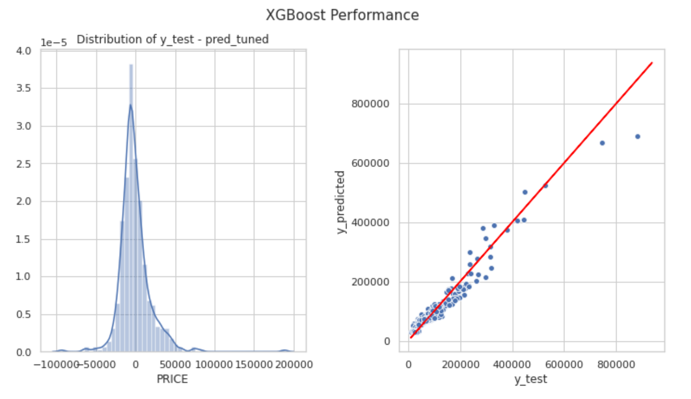
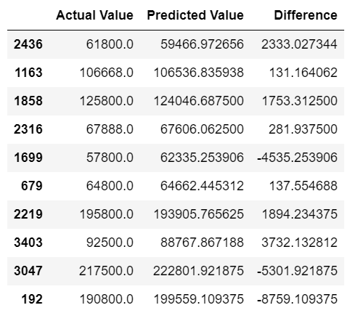
XGBoost Regressor
Model | R² Score | MAE | RMSE
XGBoost Regressor | 0.97203 | 7097.226 | 12973.072

Slide 25
Conclusion/Future Idea
1
2
How can the XGBoost Regression Model be used?
Incorporation of other vehicle types (etc Lorry, Trucks)
With easily accessible information of a car such as Car Age, mileage, OMV, can get a rough idea of how much a used car in singapore would cost based on just its physical features
Allow comprehensive study on a wider range of vehicles
Model can be applied on a wider scope

Slide 26
Thank You

Slide 27
References
Singapore Used Car. https://www.sgcarmart.com/tools_tips/index.php (accessed 10 Sep, 2022)
Used Cars in Singapore – A Complete Guide to Buying Your First Second-hand Car. https://blog.moneysmart.sg/transportation/used-cars-singapore/ (accessed 25 Sep, 2022)
Buying A Second-Hand Car — What You Need To Know About COE And Insurance. https://www.singsaver.com.sg/blog/buying-a-second-hand-car-in-singapore (accessed 02 Oct, 2022)

